Slide 1
Operating Systems
Virtual Memory Management

Slide 2
Virtual Memory Management
Background
Demand Paging
Page Replacement Algorithms
Virtual Memory Policies

Slide 3
Background
Code needs to be in memory to execute, but entire program rarely used:
  Error code, unusual routines, large data structures.
Entire program code not needed at same time.
Consider ability to execute partially-loaded program:
  Program no longer constrained by limits of physical memory.
  Each program takes less memory while running ->
  more programs run at the same time:
    Increased CPU utilization and throughput with no increase in response time or turnaround time.
  Less I/O needed to load or swap programs into memory -> each user program runs faster.

Slide 4
Background
Virtual memory – separation of user logical memory from physical memory:
  Only part of the program needs to be in memory for execution.
  Logical address space can therefore be much larger than physical address space.
  Allows address spaces to be shared by several processes.
  Allows for more efficient process creation.
  More programs running concurrently.
  Less I/O needed to load or swap processes.

Slide 5
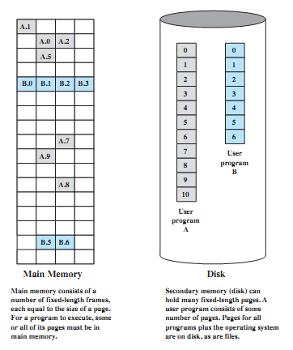
Virtual Memory Components

Slide 6
Background
Virtual address space – logical view of how process is stored in memory:
  Usually start at address 0, contiguous addresses until end
  of space.
  Meanwhile, physical memory organized in page frames.
  MMU must map logical to physical.
Virtual memory can be implemented via:
  Demand paging
  Demand segmentation

Slide 7
Background
Based on Paging/Segmentation, a process may be broken up into pieces (pages or segments) that do not need to be located contiguously in main memory.
Based on the Locality Principle, all pieces of a process do not need to be loaded in main memory during execution; all addresses are virtual.
The memory referenced by a virtual address is called virtual memory:
  It is mainly maintained on secondary memory (disk).
  pieces are brought into main memory only when needed.

Slide 8
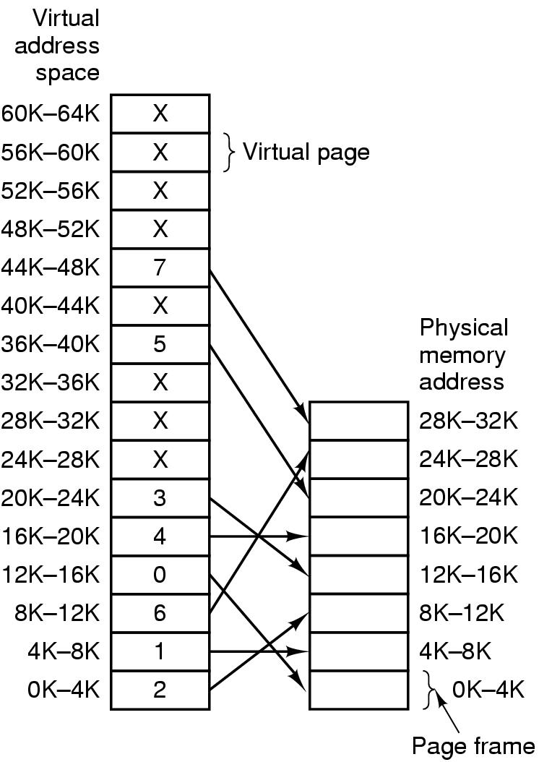
Virtual Memory Example

Slide 9
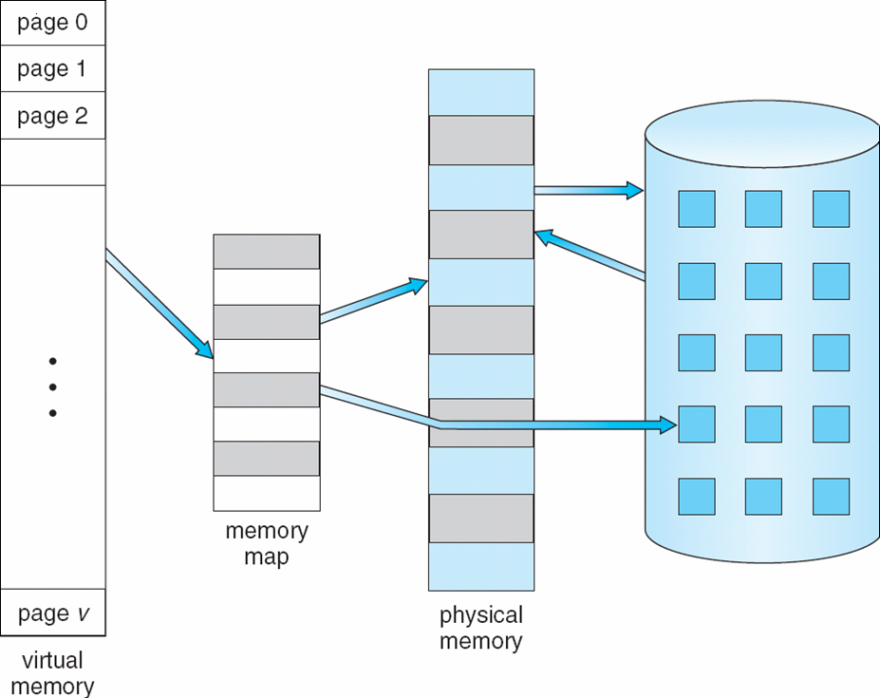
Virtual Memory that is larger than Physical Memory

Slide 10
Advantages of Partial Loading
More processes can be maintained in main memory:
  only load in some of the pieces of each process.
  with more processes in main memory, it is more likely that a process will be in the Ready state at any given time.
A process can now execute even if it is larger than the main memory size:
  it is even possible to use more bits for logical addresses than the bits needed for addressing the physical memory.

Slide 11
Support needed for Virtual Memory
Memory management hardware must support paging and/or segmentation.
OS must be able to manage the movement of pages and/or segments between external memory and main memory, including placement and replacement of pages/segments.

Slide 12

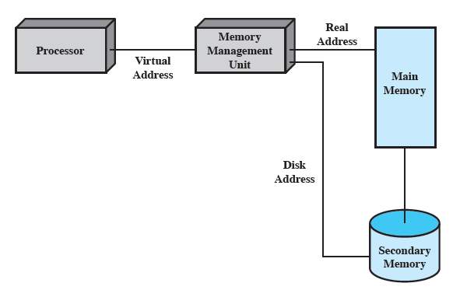
Virtual Memory Addressing

Slide 13

Virtual-address Space
Usually design logical address space for stack to start at Max logical address and grow “down” while heap grows “up”:
  Maximizes address space use.
  Unused address space between the two is hole.
  No physical memory needed until heap or stack grows to a given new page.
Enables sparse address spaces with holes left for growth, dynamically linked libraries, etc.
System libraries shared via mapping into virtual address space.
Shared memory by mapping pages read-write into virtual address space.
Pages can be shared during fork(), speeding process creation.

Slide 14

Shared Library using Virtual Memory

Slide 15
Process Execution
The OS brings into main memory only a few pieces of the program (including its starting point).
Each page/segment table entry has a valid-invalid bit that is set only if the corresponding piece is in main memory.

Slide 16
Process Execution
An interrupt (memory fault) is generated when the memory reference is on a piece that is not present in main memory.
OS places the process in a Blocking state.
OS issues a disk I/O Read request to bring into main memory the piece referenced to.
Another process is dispatched to run while the disk I/O takes place.
An interrupt is issued when disk I/O completes; this causes the OS to place the affected process back in the Ready state.

Slide 17
Demand Paging
Bring a page into memory only when it is needed:
  Less I/O needed, no unnecessary I/O
  Less memory needed
  Faster response
  More users
Page is needed ⇒ reference to it:
  invalid reference ⇒ abort
  not-in-memory ⇒ bring to memory
Similar to paging system with swapping.
Lazy swapper – never swaps a page into memory unless page will be needed; Swapper that deals with pages is a pager.

Slide 18
Valid-Invalid Bit
With each page table entry, a valid–invalid (present-absent) bit is associated
(v ⇒ in-memory, i ⇒ not-in-memory).
Initially valid–invalid bit is set to i on all entries.
Example of a page table snapshot:
During address translation, if valid–invalid bit in page table entry
is i ⇒ page fault.
Frame #
valid-invalid bit
v
v
v
v
i
….
i
i

Slide 19
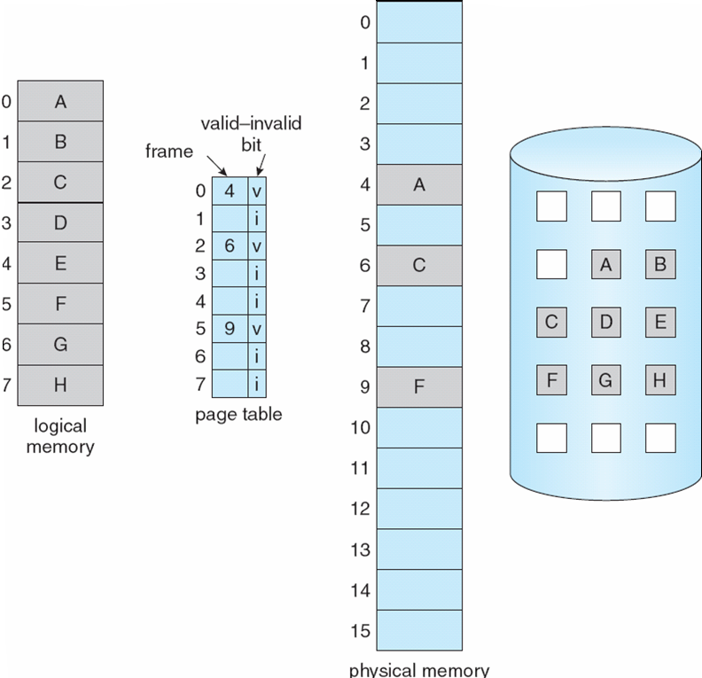
Page Table when some
Pages are not in Main Memory

Slide 20
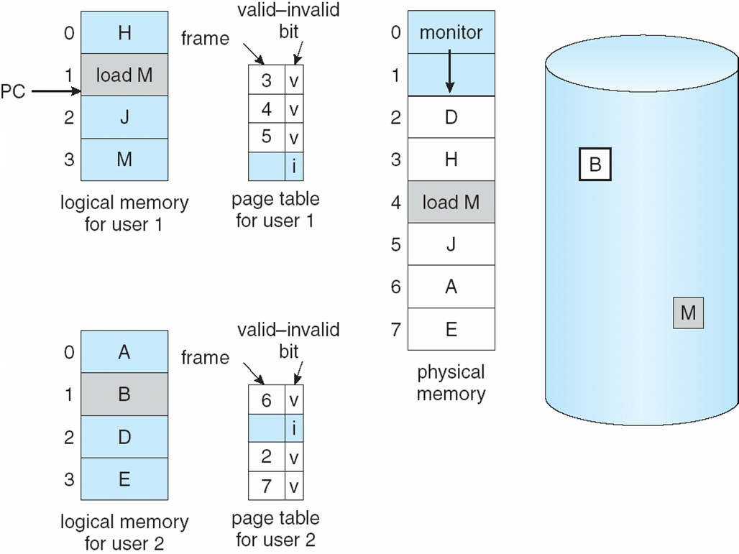
Need For Page Fault/Replacement

Slide 21

Steps in handling a Page Fault

Slide 22
Steps in handling a Page Fault
If there is ever a reference to a page not in memory, first reference will cause page fault.
Page fault is handled by the appropriate OS service routines.
Locate needed page on disk (in file or in backing store).
Swap page into free frame (assume available).
Reset page tables – valid-invalid bit = v.
Restart the instruction that caused the page fault.

Slide 23
What happens if there is no free frame?
Page replacement – find some page in memory, but not really in use, swap it out.
Need page replacement algorithm.
Performance – want an algorithm which will result in minimum number of page faults.
Same page may be brought into memory several times.

Slide 24
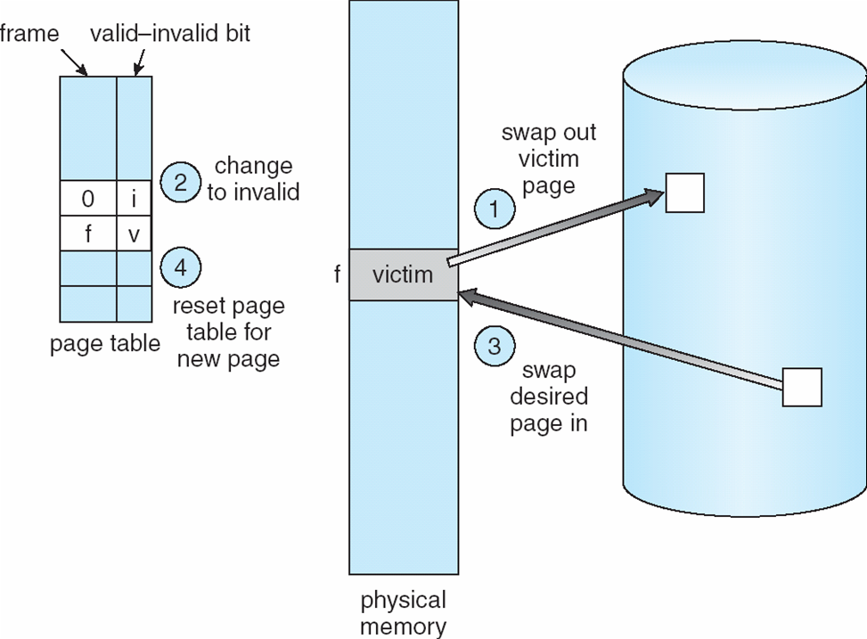
Steps in handling a Page Replacement (1)

Slide 25
Steps in handling a Page Replacement (2)
Find the location of the desired page on disk.
Find a free frame:
  If there is a free frame, use it.
  If there is no free frame, use a page replacement algorithm to select a victim page.
Bring the desired page into the (newly) free frame; update the page and frame tables.
Restart the process.

Slide 26
Comments on Page Replacement
Prevent over-allocation of memory by modifying page-fault service routine to include page replacement.
Use modify (dirty) bit to reduce overhead of page transfers – only modified pages are written to disk.
Page replacement completes separation between logical memory and physical memory – large virtual memory can be provided on a smaller physical memory.

Slide 27
Stages in Demand Paging (worse case)
Trap to the operating system.
Save the user registers and process state.
Determine that the interrupt was a page fault.
Check that the page reference was legal and determine location of page on the disk.
Issue a read from the disk to a free frame:
  Wait in a queue for this device until the read request is serviced.
  Wait for the device seek and/or latency time.
  Begin the transfer of the page to a free frame.
While waiting, allocate the CPU to some other user.
Receive an interrupt from the disk I/O subsystem (I/O completed).
Save the registers and process state for the other user.
Determine that the interrupt was from the disk.
Correct the page table and other tables to show page is now in memory.
Wait for the CPU to be allocated to this process again.
Restore the user registers, process state, and new page table, and then resume the interrupted instruction.

Slide 28
Performance of Demand Paging
Three major activities:
  Service the interrupt – careful coding means just several hundred
  instructions needed.
  Read the page – lots of time..
  Restart the process – again just a small amount of time
Page Fault Rate 0 ≤ p ≤ 1
  if p = 0, no page faults.
  if p = 1, every reference is a fault.
Effective Access Time (EAT) –
EAT = (1 – p) x memory access
+ p x (page fault overhead
+ [swap page out]
+ swap page in
+ restart overhead)

Slide 29
Demand Paging Example
Memory access time = 200 nanoseconds.
Average page-fault service time = 8 milliseconds.
EAT = (1 – p) x 200 + p (8 milliseconds)
= (1 – p) x 200 + p x 8,000,000
= 200 + p x 7,999,800
If one access out of 1,000 causes a page fault, then
EAT = 8.2 microseconds.
This is a slowdown by a factor of 40!!
If want performance degradation < 10 percent
  220 > 200 + 7,999,800 x p
  20 > 7,999,800 x p
  p < .0000025
  < one page fault in every 400,000 memory accesses.

Slide 30
Copy-on-Write
Copy-on-Write (COW) allows both parent and child processes to initially share the same pages in memory.
If either process modifies a shared page, only then is the page copied.
COW allows more efficient process creation as only modified pages are copied.

Slide 31
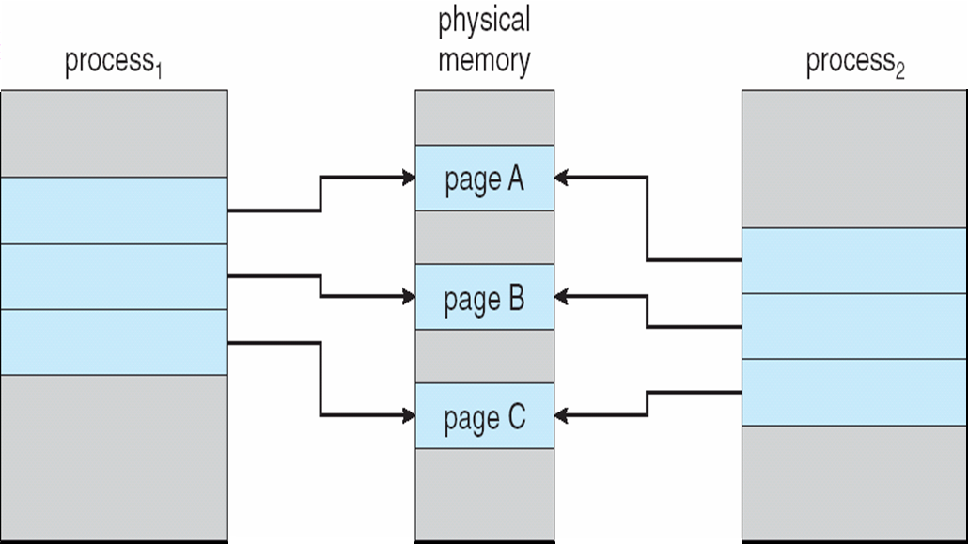
Before Process 1 Modifies Page C

Slide 32

After Process 1 Modifies Page C

Slide 33
What Happens if there is no Free Frame?
Page replacement – find some page in memory,
but not really in use, page it out:
  Algorithm – terminate? swap out? replace the page?
  Performance – want an algorithm which will result in minimum number of page faults.
Same page may be brought into memory several times.

Slide 34
Page Replacement Algorithms
Want lowest page-fault rate.
Evaluate algorithm by running it on a particular string of memory references (reference string) and computing the number of page faults and page replacements on that string.
In all our examples, we use a few recurring reference strings.

Slide 35

Graph of Page Faults vs. the Number of Frames

Slide 36
The FIFO Policy
Treats page frames allocated to a process as a circular buffer:
  When the buffer is full, the oldest page is replaced. Hence first-in, first-out:
    A frequently used page is often the oldest, so it will be repeatedly paged out by FIFO.

Slide 37
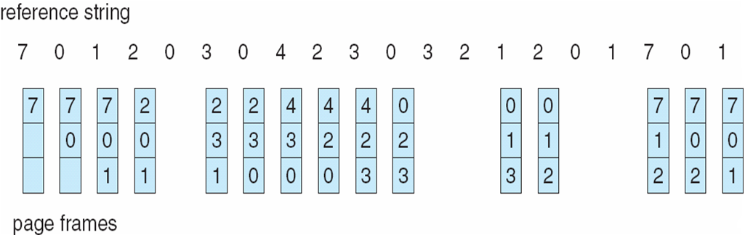
FIFO Page Replacement

